Slide 1
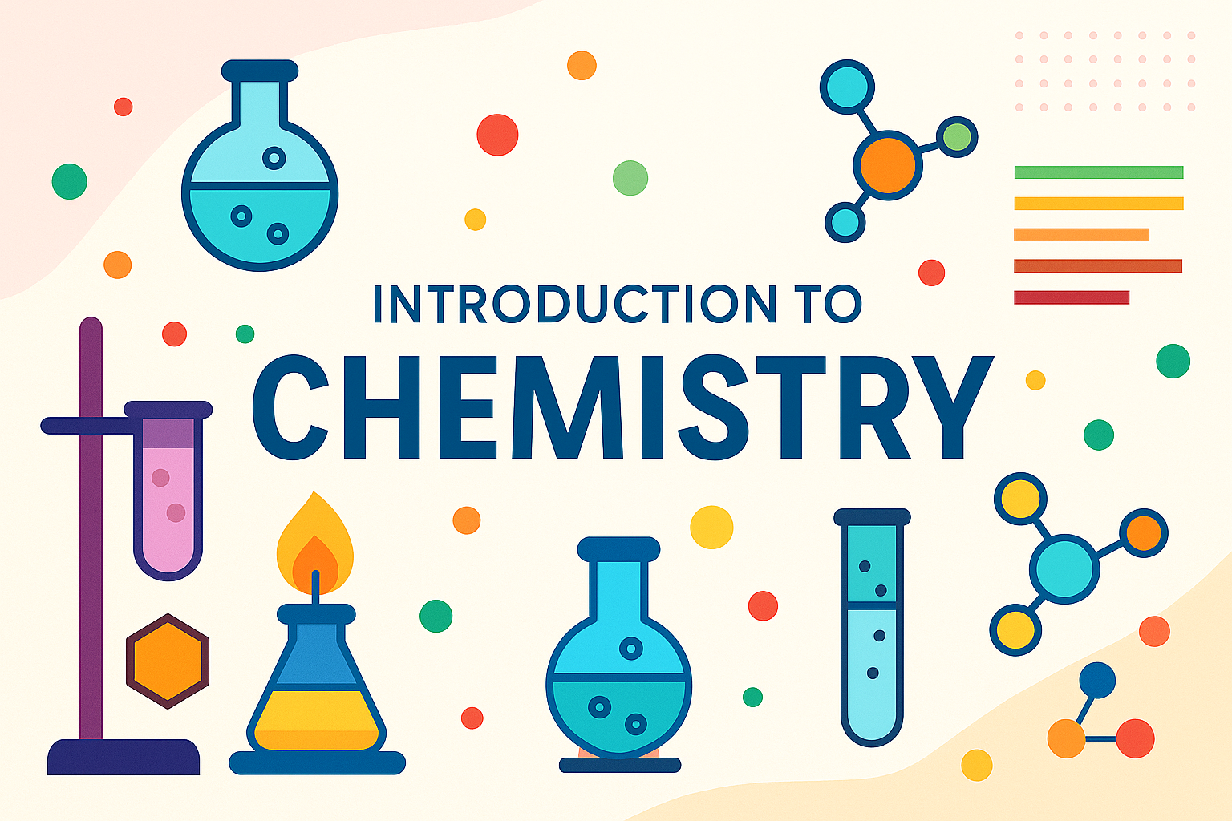

Slide 2
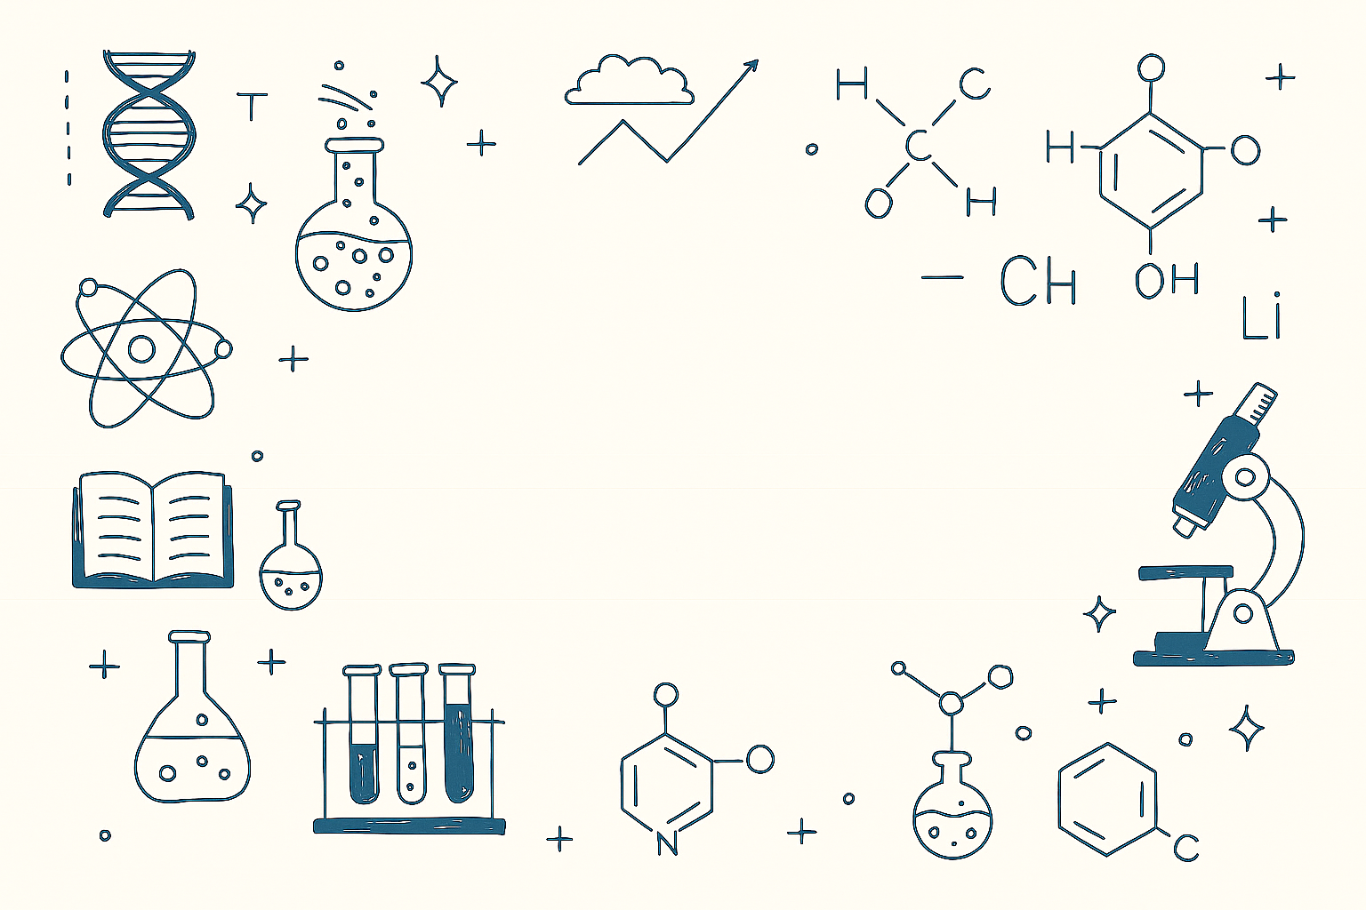
What is Chemistry?
Chemistry is the study of matter – everything that has mass and takes up space
Types of Chemistry:
Organic – carbon containing compounds
Inorganic – non carbon containing compounds
Physical
Analytical

Slide 3
Where Did Elements Come From?
💥 The Big Bang and the first elements
About 13.8 billion years ago, the universe began with the Big Bang. An unimaginably hot, dense point expanding rapidly.
In the first few minutes, only the simplest elements formed:
Hydrogen nuclei (protons)
Helium nuclei (2 protons + 2 neutrons)
Tiny traces of lithium and beryllium.
These early elements were the "cosmic soup" that filled the young universe.

Slide 4
🌟 Stellar nucleosynthesis: Stars as element factories
After millions of years, gravity pulled hydrogen and helium together into stars.
Inside stars, intense heat and pressure fuse smaller nuclei into heavier elements:
Hydrogen → Helium (via fusion)
Helium → Carbon, Oxygen, and so on (in massive stars).
💥 Supernova explosions: The cosmic forge
Massive stars explode as supernovae, releasing even heavier elements (iron, gold, uranium) into space.
These elements spread as cosmic dust, eventually forming new stars, planets, and eventually Earth.

Slide 5
🌍 How did these elements come to Earth?
About 4.6 billion years ago, a cloud of gas and dust collapsed under gravity to form our Solar System.
The Sun formed in the center, and leftover debris clumped into planets, including Earth.
Heavy elements sank to Earth's core, while lighter elements formed the crust and atmosphere.

Slide 6
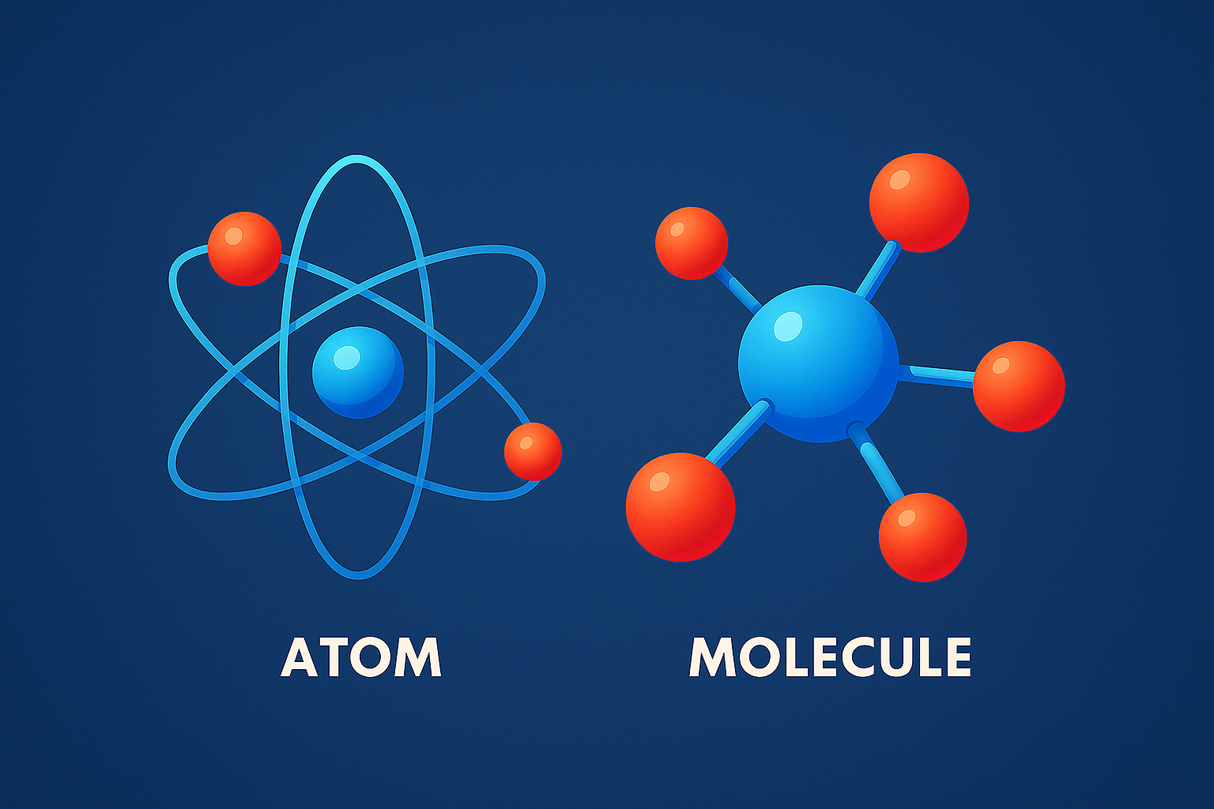
Atoms
The smallest unit of an element that retains its chemical properties.
There are more than 100 types of atoms
All the matter around us are made up of atoms
Materials made of only one sort of atoms are called elements (O2)
Materials made of different sorts of atoms are called compounds (H2O)
All known elements can be found in the periodic table

Slide 7
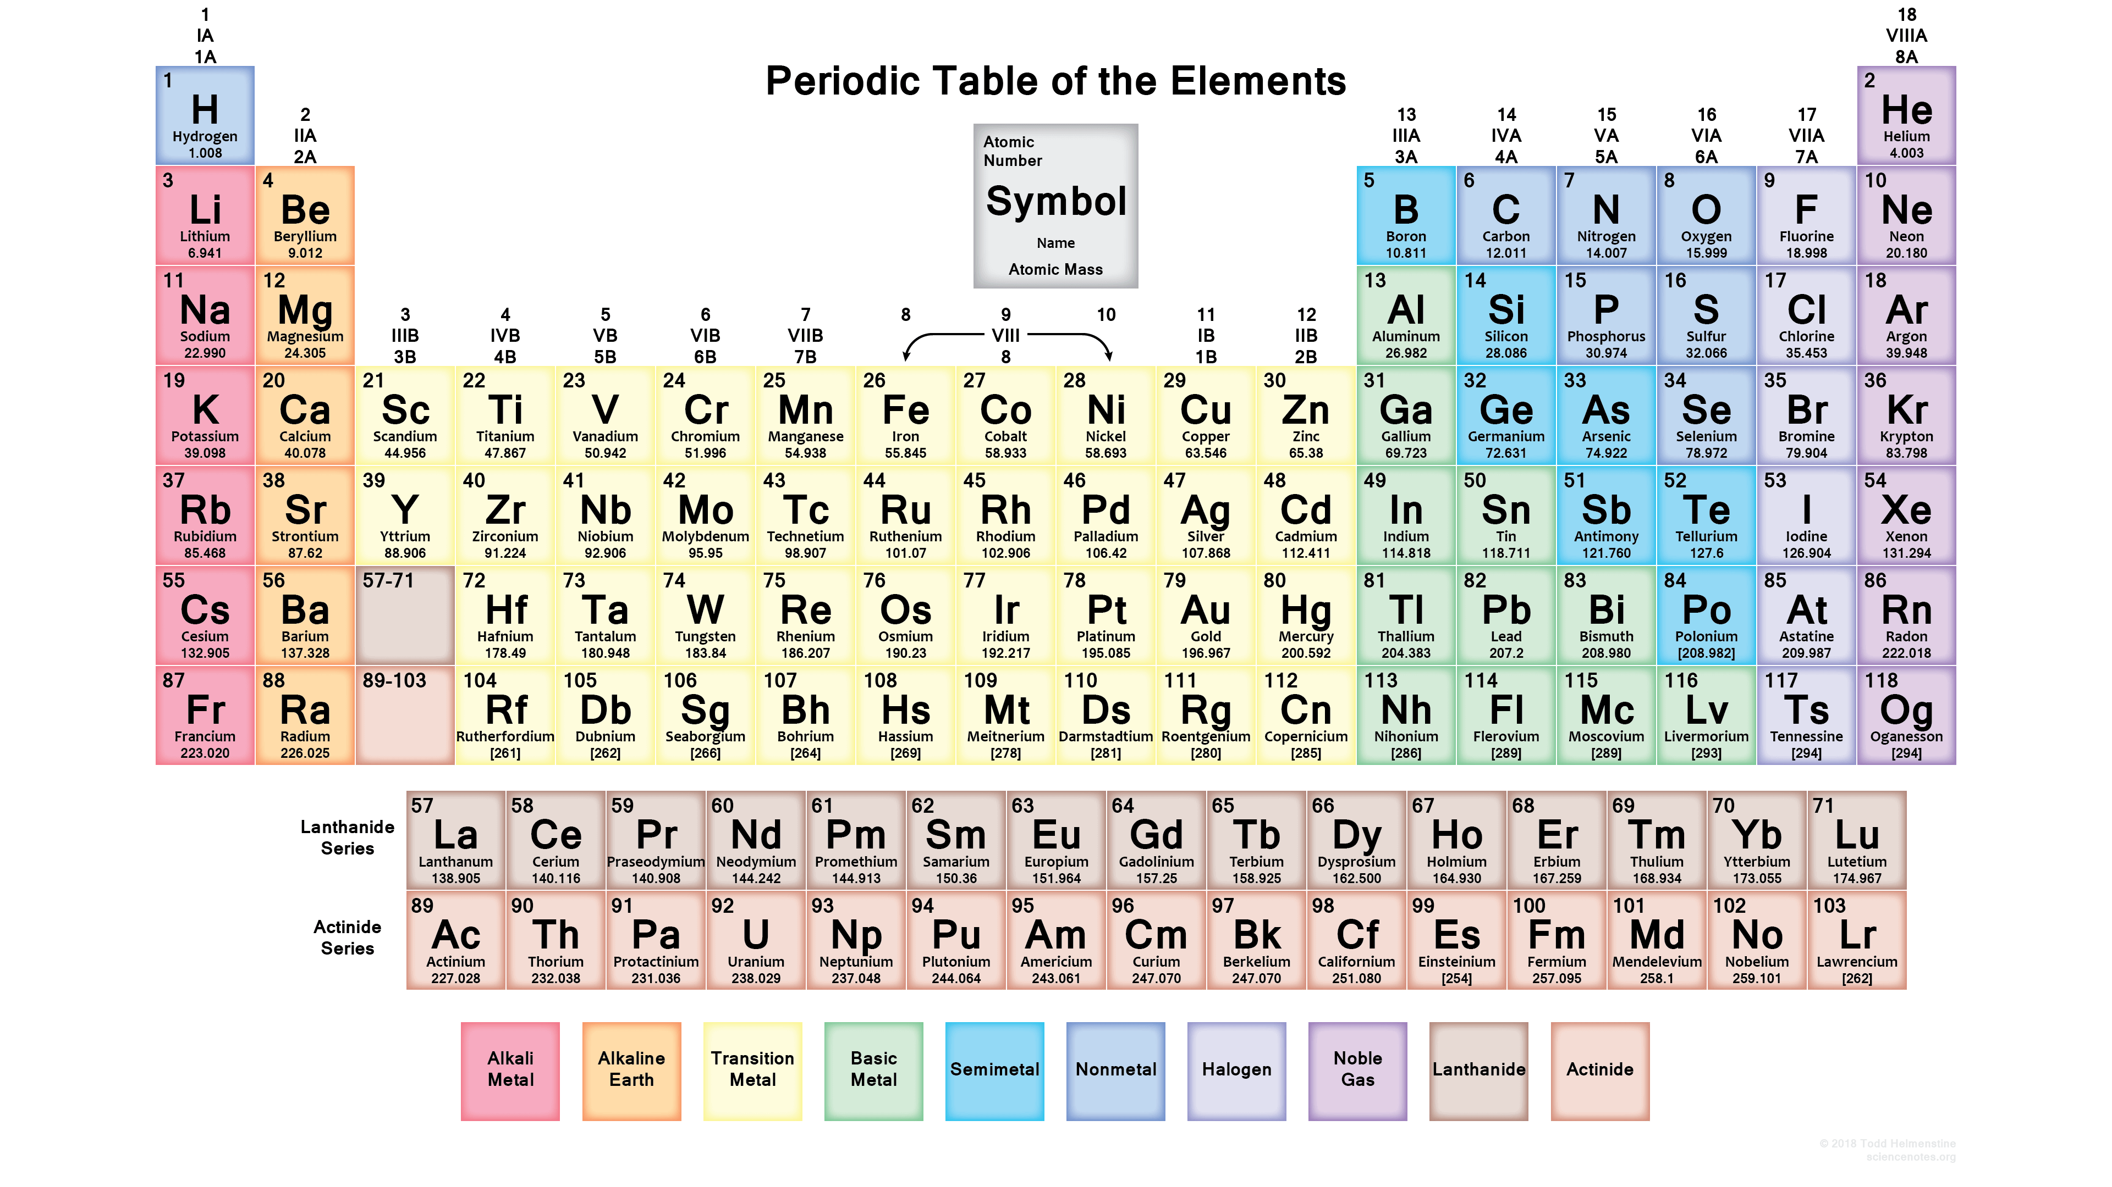

Slide 8
Periodic Table
The periodic table was introduced by the Russian chemist Demetri Mendeleev
It is sorted according to the atomic number and grouped based on each elements characteristics, so that similar type of elements can be found together in the table.
Initially it left empty spaces for undiscovered elements to be filled in later.
There are 103 elements on the periodic table
Each elements is represented by a letter, or two letters usually the first letter of the element’s name
Some elements use their Latin name

Slide 9
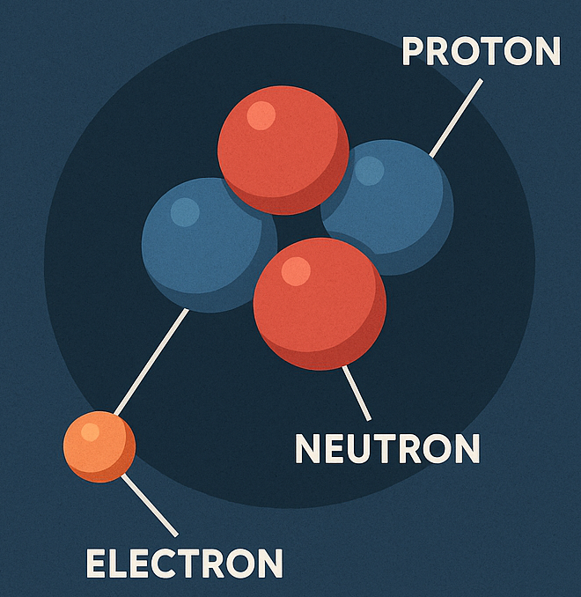
Sub Atomic Particles
Atoms are made up of
Protons
Neutrons
Electrons
Most of the atoms mass is made up from protons and neutrons
The mass of electrons are considered zero or negligible
Protons and neutrons sit in the center of an atom which we call the nucleus whereas electrons orbit the nucleus in an electron cloud

Slide 10
Protons are positively charged (+1)
Electrons are negatively charged (-1)
Neutrons are not charged
We define elements based on how many protons they have
Number of protons = atomic number
The number of protons cant change
In a neutral atom of an element, the number of electrons should be the same as the number of protons to cancel out the opposite charge
Since electrons are freely moving they can be gained, lost or shared with other atoms hence controlling chemical behavior and bonding
This creates an imbalance in the charge of an atom
Charged atoms are called ions

Slide 11
Since neutrons are not charged, the number of neutrons in an atom doesn’t really matter
It provides stability to the nucleus which would otherwise be filled with + charged protons repelling each other
Some atoms of the same elements can contain different number of neutrons
These are called isotopes (c-6, c12)
The chemistry of isotopes are the same, only difference is the mass
If there are too many neutrons in a nucleus, it becomes so massive that it becomes unstable
It may split up into smaller atoms
This is called radioactivity

Slide 12
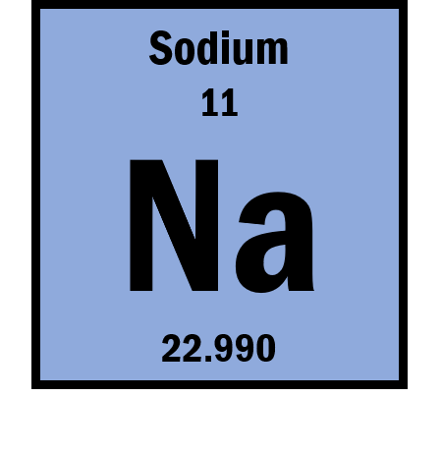
Atomic Number
Atomic Mass
Each element in the periodic table shows the atomic number (top left), and the atomic mass (bottom left)

Slide 13
Atomic Number (Z) = Number of Protons
Example: Carbon Z = 6 -> 6 protons
Mass Number (A) = Number of Protons + Number of Neutrons
Example: Carbon-12 A = 12 -> 6 protons + 6 neutrons
Neutron Count = A - Z
Example: Oxygen A = 16
Neutron count = 16-8 = 8

Slide 14
Atomic Number = Number of protons = 11
Number of electrons = 11
Atomic Mass = 23
Number of Neutrons = 23 – 11 = 12

Slide 15
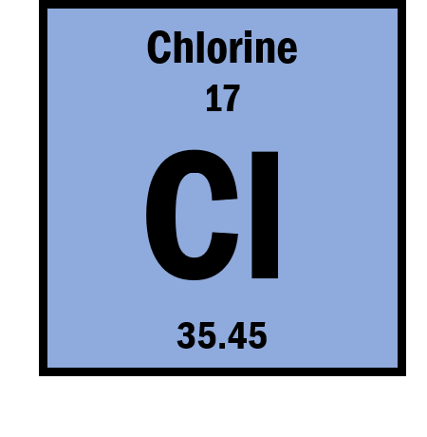
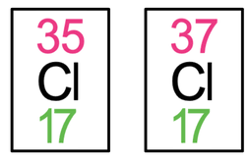
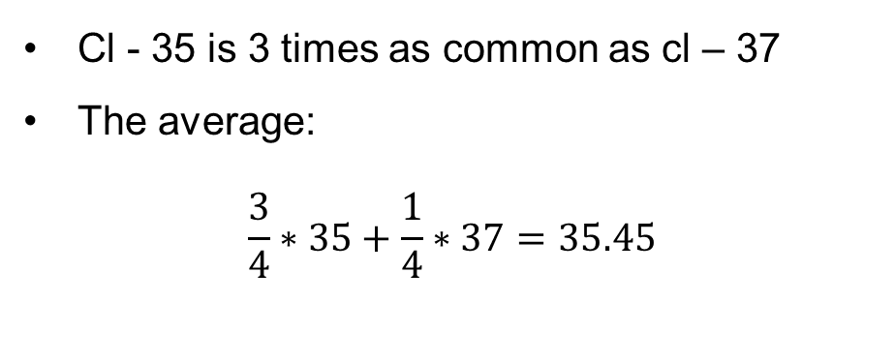
If you observe the periodic table, you will see that the atomic mass of some elements are not whole numbers
This is due to those elements having isotopes
If we take Chlorine, there are two known isotopes: Cl – 35 and Cl - 37
Cl - 35 is 3 times as common as cl – 37
The average:
$$\frac{3}{4}∗35+\frac{1}{4}∗37=35.45$$

Slide 16
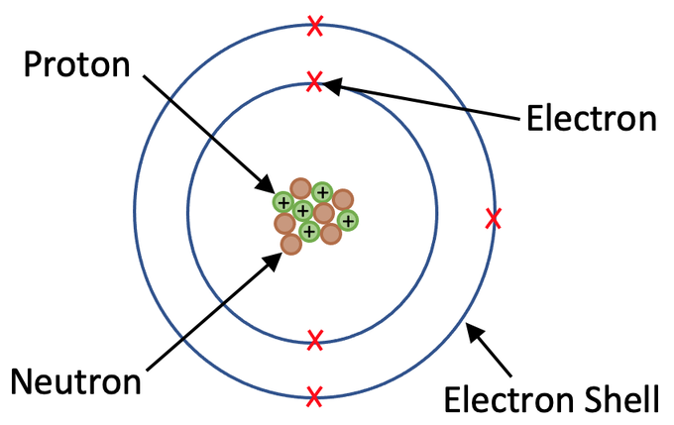
Lighter elements have usually the same number of neutrons as protons (Hydrogen)
Heavier elements tend to have more neutrons to glue the nucleus together
Electrons are not exactly completely free to roam around the nucleus as it seems
They are restricted to moving in fixed orbitals or energy levels
Each energy level can take a certain number of electrons before its full
Any additional electrons will have to occupy energy levels further out
These are called electron shells

Slide 17
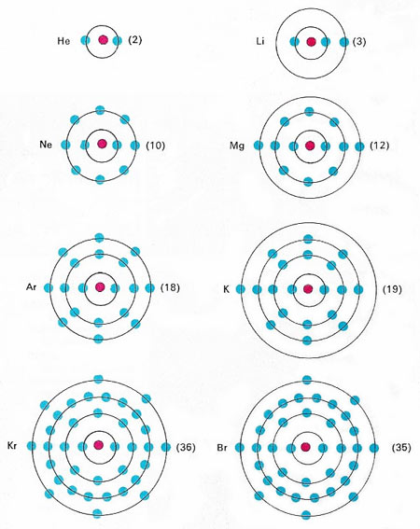
Theoretically there is no limit to the number of electron shells that can exist
In reality we observe up to 7 electron shells in naturally occurring elements
Shell | Symbol | n value | Max electrons formula: 2n² | Max electrons
1st shell | K | n = 1 | 2 × 1² = 2 | 2
2nd shell | L | n = 2 | 2 × 2² = 8 | 8
3rd shell | M | n = 3 | 2 × 3² = 18 | 18
4th shell | N | n = 4 | 2 × 4² = 32 | 32
5th shell | O | n = 5 | 2 × 5² = 50 | 50
6th shell | P | n = 6 | 2 × 6² = 72 | 72
7th shell | Q | n = 7 | 2 × 7² = 98 | 98

Slide 18
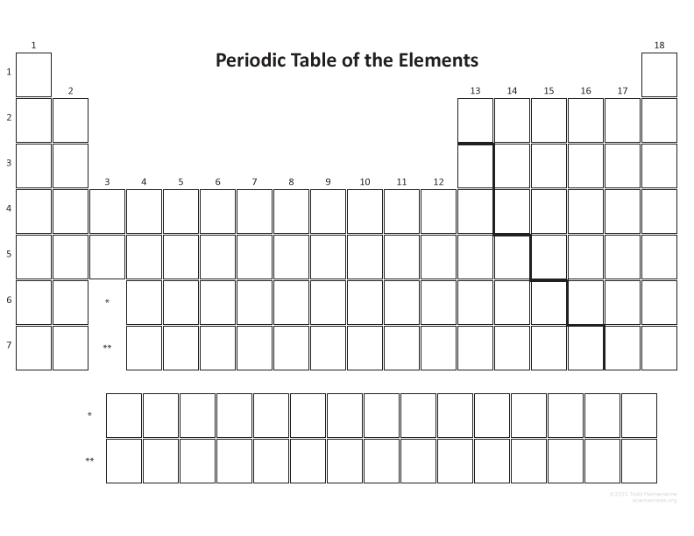
The periodic table has 7 rows going across called periods
18 columns called groups
Elements are arranged according to the atomic number
An elements period indicates the elements electrons shell that is being filled
Take Na and Cl for example. In both cases it’s the 3rd shell that’s being filled.
The number of electrons in the outer most shell is indicated in the last digit of the group number
Electronic configuration: 2:8:1 2:8:7

Slide 19
As discussed earlier, electrons of an atom is responsible for chemical reactions and bonding
In the periodic table, all elements in a particular group has the same number of electrons in the outer shell
Therefore, they have similar chemical properties

Slide 20
Summary
🖌️Draw a atoms for
1️⃣Nitrogen
2️⃣Hydrogen
3️⃣ Florine
4️⃣Magnesium
🧮 Calculate protons, neutrons, electrons for each.
📝 Mini quiz
1️⃣ What subatomic particle defines an element's identity? 2️⃣ If an atom has A = 23 and Z = 11, how many neutrons does it have? 3️⃣ Which is heavier: proton or electron? 4️⃣ Where are electrons likely found?

Slide 21
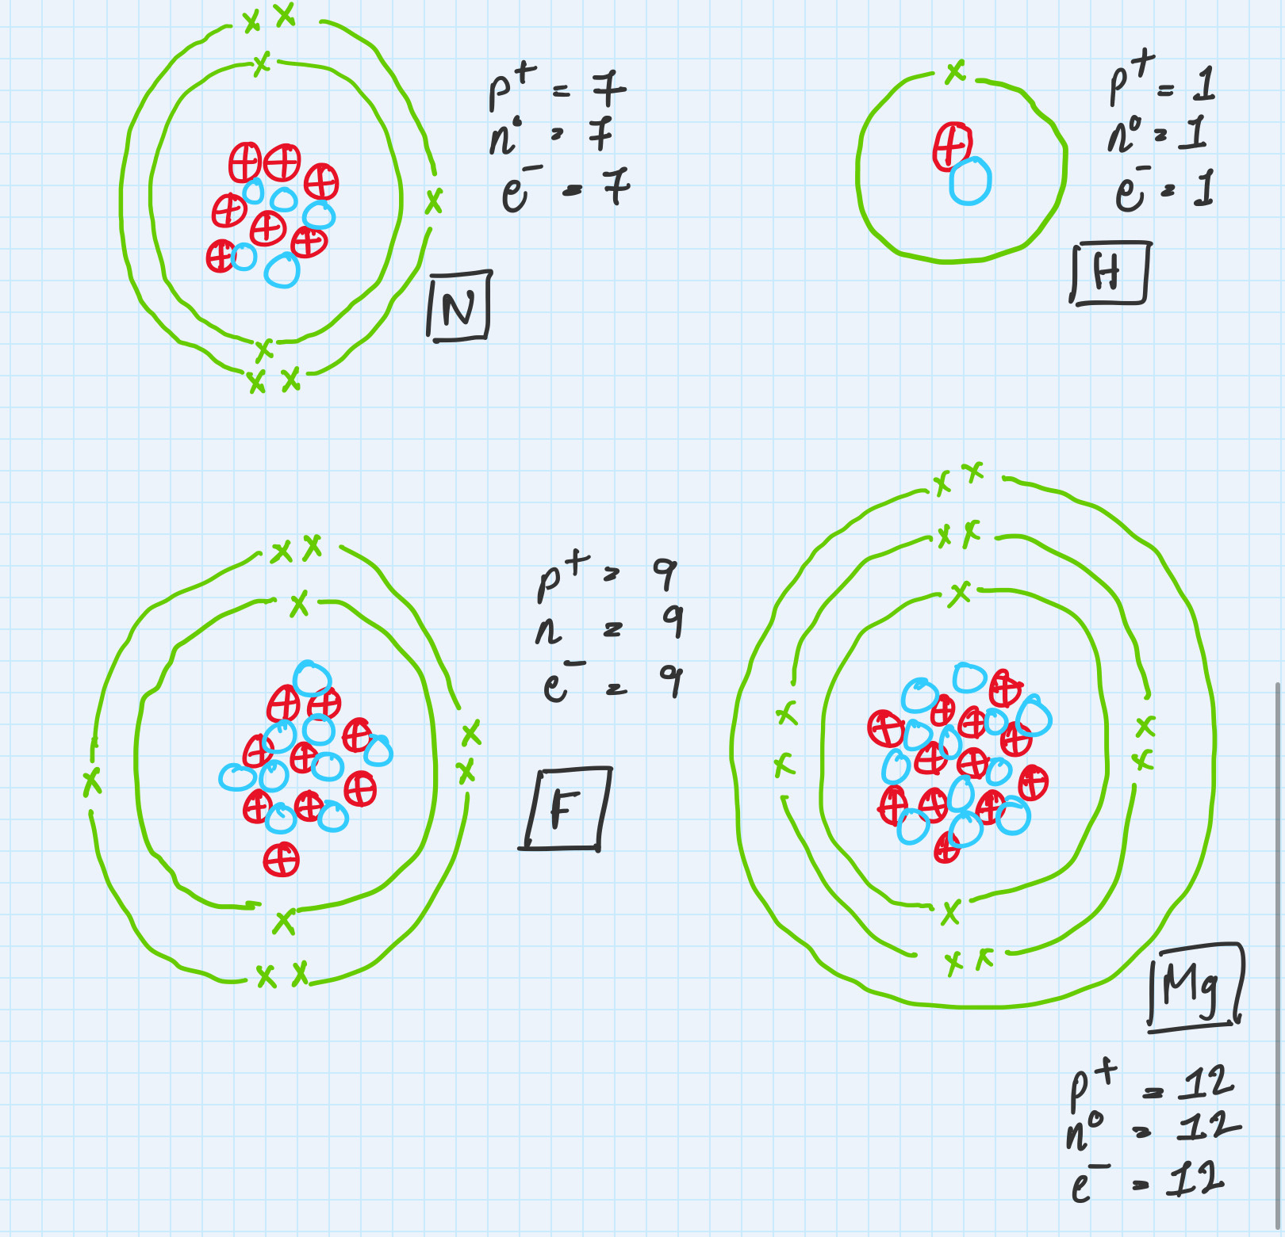
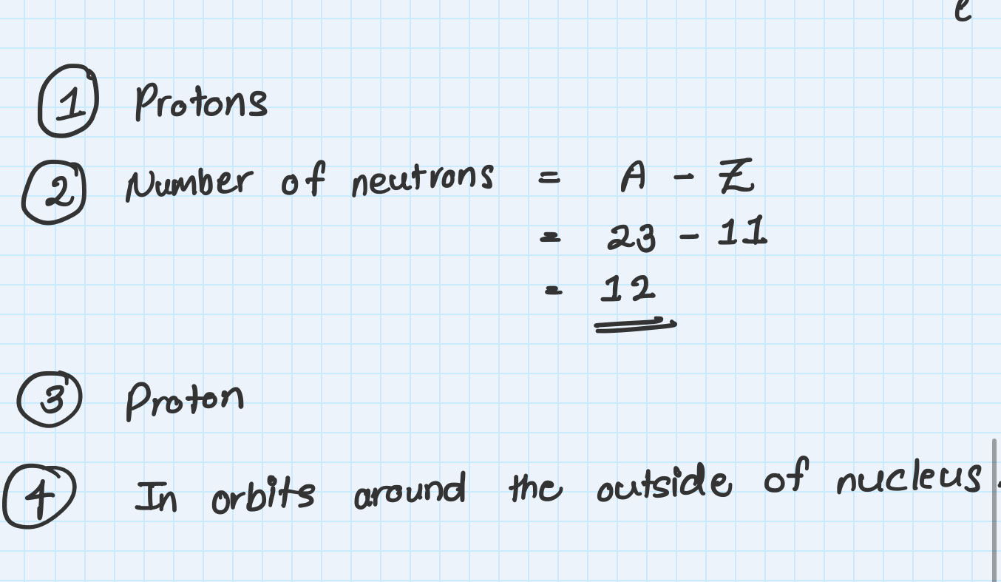
Answers:

